Slide 1
Insertion sort

Slide 2
Outline
In this lesson, we will:
Describe the insertion sort algorithm
Look at an example
Determine how the algorithm work
Create a flow chart
Implement the algorithm
Look at the run times
Consider some optimizations

Slide 3
The idea
Suppose we have an array where the first k entries are sorted:
From this, we can move the (k + 1)^{st} entry into the correct location by swapping
This makes an array where the first k + 1 entries are sorted
We can then proceed forward by adding the (k + 2)^{nd} entry into the array and so on

Slide 4
Example
For example, consider this array:
Just the first entry is by itself sorted
0 | 1 | 2 | 3 | 4 | 5 | 6 | 7 | 8 | 9
82 | 25 | 42 | 85 | 16 | 32 | 42 | 4 | 28 | 7

Slide 5
Example
We want to add 25, so we swap 25 and 82
Now the first two entries are sorted:
0 | 1 | 2 | 3 | 4 | 5 | 6 | 7 | 8 | 9
82 | 25 | 42 | 85 | 16 | 32 | 42 | 4 | 28 | 7
0 | 1 | 2 | 3 | 4 | 5 | 6 | 7 | 8 | 9
25 | 82 | 42 | 85 | 16 | 32 | 42 | 4 | 28 | 7

Slide 6
Example
We want to add 42, so we swap 42 and 82
Now the first three entries are sorted:
0 | 1 | 2 | 3 | 4 | 5 | 6 | 7 | 8 | 9
25 | 82 | 42 | 85 | 16 | 32 | 42 | 4 | 28 | 7
0 | 1 | 2 | 3 | 4 | 5 | 6 | 7 | 8 | 9
25 | 42 | 82 | 85 | 16 | 32 | 42 | 4 | 28 | 7

Slide 7
Example
We want to add 85, but it is already in place
Now the first four entries are sorted:
0 | 1 | 2 | 3 | 4 | 5 | 6 | 7 | 8 | 9
25 | 42 | 82 | 85 | 16 | 32 | 42 | 4 | 28 | 7
0 | 1 | 2 | 3 | 4 | 5 | 6 | 7 | 8 | 9
25 | 42 | 82 | 85 | 16 | 32 | 42 | 4 | 28 | 7

Slide 8
Example
We want to add 16, so we keep swapping until it falls in place:
Now the first five entries are sorted:
0 | 1 | 2 | 3 | 4 | 5 | 6 | 7 | 8 | 9
25 | 42 | 82 | 85 | 16 | 32 | 42 | 4 | 28 | 7
0 | 1 | 2 | 3 | 4 | 5 | 6 | 7 | 8 | 9
16 | 25 | 42 | 82 | 85 | 32 | 42 | 4 | 28 | 7

Slide 9
Example
As a last example, 32 requires only three swaps
Now the first six entries are sorted:
Notice that once we stopped swapping, we were finished
0 | 1 | 2 | 3 | 4 | 5 | 6 | 7 | 8 | 9
16 | 25 | 42 | 82 | 85 | 32 | 42 | 4 | 28 | 7
0 | 1 | 2 | 3 | 4 | 5 | 6 | 7 | 8 | 9
16 | 25 | 32 | 42 | 82 | 85 | 42 | 4 | 28 | 7

Slide 10
Example
After four more operations, the array will be sorted
0 | 1 | 2 | 3 | 4 | 5 | 6 | 7 | 8 | 9
4 | 7 | 16 | 25 | 28 | 32 | 42 | 42 | 82 | 85

Slide 11
Insertion sort
Let’s step through the algorithm for an array of capacity 10:
Keep swapping the 2nd entry until we are at the front or it is in place
Keep swapping the 3rd entry until we are at the front or it is in place
Keep swapping the 4th entry until we are at the front or it is in place
Keep swapping the 5th entry until we are at the front or it is in place
Keep swapping the 6th entry until we are at the front or it is in place
Keep swapping the 7th entry until we are at the front or it is in place
Keep swapping the 8th entry until we are at the front or it is in place
Keep swapping the 9th entry until we are at the front or it is in place
Keep swapping the 10th entry until we are at the front or it is in place
At this point, the array is sorted

Slide 12
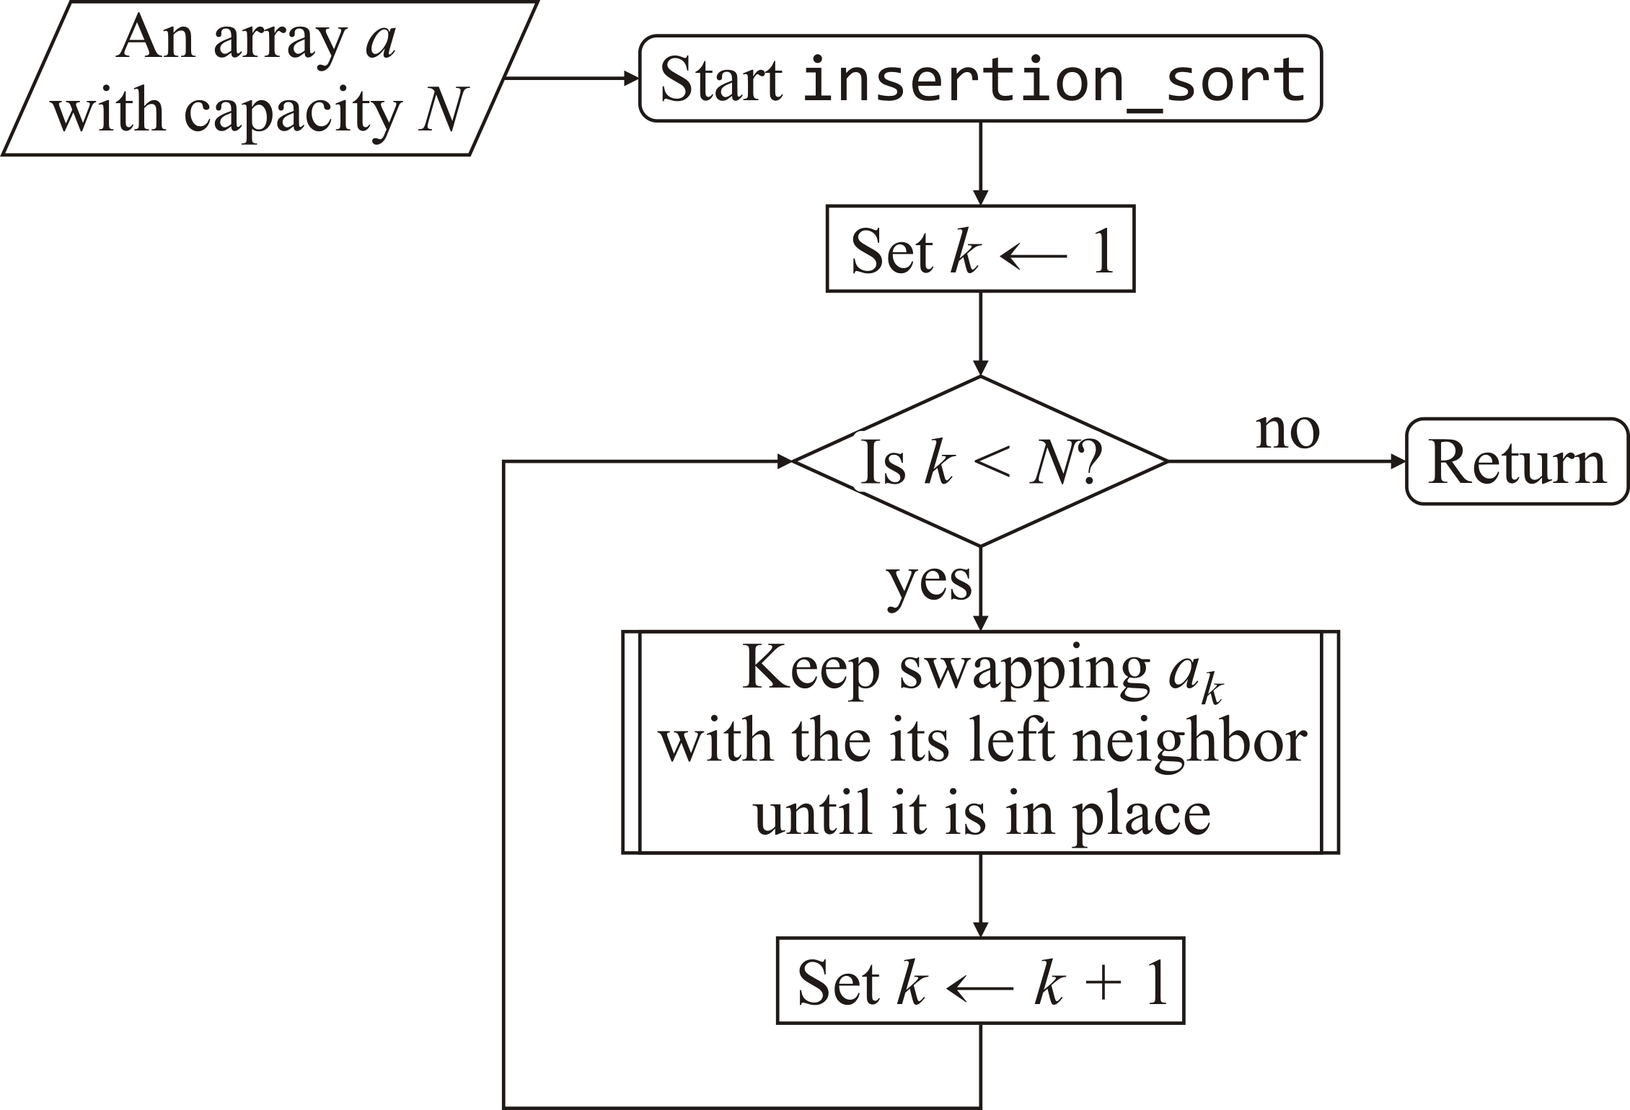
Insertion sort
Here is a flow chart:

Slide 13
Insertion sort
Let us implement this function:
void insertion_sort( double array[], std::size_t const capacity ) {
for ( std::size_t k{1}; k < capacity; ++k ) {
// Keep swapping to the left
}
}

Slide 14
Insertion sort
Walking backward, we compare and if necessary swap
void insertion_sort( double array[], std::size_t const capacity ) {
for ( std::size_t k{1}; k < capacity; ++k ) {
// Keep swapping to the left
for ( std::size_t i{k}; i > 0; --i ) {
if ( array[i - 1] > array[i] ) {
std::swap( array[i - 1], array[i] );
} else {
}
}
}
}

Slide 15
Insertion sort
If no swap is necessary, we are finished: we break out of the loop
void insertion_sort( double array[], std::size_t const capacity ) {
for ( std::size_t k{1}; k < capacity; ++k ) {
// Keep swapping to the left
for ( std::size_t i{k}; i > 0; --i ) {
if ( array[i - 1] > array[i] ) {
std::swap( array[i - 1], array[i] );
} else {
// If array[i - 1] >= array[i], they are in order
break;
}
}
}
}
We break to the end of the inner-most loop containing this break statement

Slide 16
Run time
How long does this take to run?
For an array of size 10:
We compared 1 pair of entries, and perform up to 1 swap
We compared up to 2 pairs of entries, and perform up to 2 swaps
We compared up to 3 pairs of entries, and perform up to 3 swaps
We compared up to 4 pairs of entries, and perform up to 4 swaps
We compared up to 5 pairs of entries, and perform up to 5 swaps
We compared up to 6 pairs of entries, and perform up to 6 swaps
We compared up to 7 pairs of entries, and perform up to 7 swaps
We compared up to 8 pairs of entries, and perform up to 8 swaps
We compared up to 9 pairs of entries, and perform up to 9 swaps
At each step, we made at least one comparison

Slide 17
Run time
How much work did we do?
We compared up to 1 + 2 + 3 + 4 + 5 + 6 + 7 + 8 + 9 = 54 pairs
We swapped up to 54 pairs of entries
If our array had n entries, we would have to:
Check
We compared at least n – 1 pairs of entries
When do we do the least amount of work?
n – 1 comparisons and no swaps?

Slide 18
Appropriate choice of for-loop
Question:
Why do we use this loop
for ( std::size_t i{k}; i > 0; --i ) {
if ( array[i - 1] > array[i] ) {
std::swap( array[i - 1], array[i] );
} else {
break;
}
}
and not this loop
for ( std::size_t i{k - 1}; i >= 0; --i ) {
if ( array[i] > array[i + 1] ) {
std::swap( array[i], array[i + 1] );
} else {
break;
}
}
?

Slide 19
Excessive assignments?
Question:
Every swap requires three assignments:
unsigned int tmp{array[i]};
array[i] = array[i - 1];
array[i - 1] = tmp;
With k swaps, this requires 3k assignments…
Is this necessary?

Slide 20
Excessive assignments?
For example, in inserting 32:
Copy 32 to a local variable:
double next_entry{array[5]};
Next, move all the
Finally, copy the local variable to the now “empty” entry:
array[3] = next_entry;
0 | 1 | 2 | 3 | 4 | 5 | 6 | 7 | 8 | 9
16 | 25 | 42 | 82 | 85 | 32 | 42 | 4 | 28 | 7
0 | 1 | 2 | 3 | 4 | 5 | 6 | 7 | 8 | 9
16 | 25 | 42 | 42 | 82 | 85 | 42 | 4 | 28 | 7
0 | 1 | 2 | 3 | 4 | 5 | 6 | 7 | 8 | 9
16 | 25 | 32 | 42 | 82 | 85 | 42 | 4 | 28 | 7

Slide 21
Excessive assignments?
This reduces the number of assignments from 3k to k + 2
Can you implement this?
void insertion_sort( double array[], std::size_t const capacity ) {
for ( std::size_t k{1}; k < capacity; ++k ) {
double next_entry{array[k]}; // Next entry to be put into place...
std::size_t next_index{k};
for ( /*...*/ ) {
// As necessary, update 'next_index' and
// shift the entries in the array
}
array[next_index] = next_entry;
}
}

Slide 22
Excessive assignments?
Recall the scope of indices for for-loops:
for ( std::size_t k{0}; k < capacity; ++k ) {
// 'k' is declared in this block
}
// 'k' is no longer defined here
If you want to access k after the end of the for-loop, you must declare it before:
std::size_t k{0};
for ( ; k < capacity; ++k ) {
// 'k' is declared in this block
}
// 'k' continues to be defined here

Slide 23
Summary
Following this lesson, you now
Understand the insertion sort algorithm
You saw an example
Watched how to convert the flow chart to an algorithm
There is a lot of time spent swapping, which can be reduced significantly
The run time is still approximately the same as selection sort

Slide 24
References
[1] Wikipedia
https://en.wikipedia.org/wiki/Insertion_sort
[2] nist Dictionary of Algorithms and Data Structures
https://xlinux.nist.gov/dads/HTML/insertionSort.html

Slide 25



Colophon
These slides were prepared using the Georgia typeface. Mathematical equations use Times New Roman, and source code is presented using Consolas.
The photographs of lilacs in bloom appearing on the title slide and accenting the top of each other slide were taken at the Royal Botanical Gardens on May 27, 2018 by Douglas Wilhelm Harder. Please see
https://www.rbg.ca/
for more information.

Slide 26
Disclaimer
These slides are provided for the ece 150 Fundamentals of Programming course taught at the University of Waterloo. The material in it reflects the authors’ best judgment in light of the information available to them at the time of preparation. Any reliance on these course slides by any party for any other purpose are the responsibility of such parties. The authors accept no responsibility for damages, if any, suffered by any party as a result of decisions made or actions based on these course slides for any other purpose than that for which it was intended.

